Slide 1

FOUNDATIONAL COMMUNICATION SKILLS
Mental Health Setting
Notes:
Say: Welcome to this training series on foundational communication skills; mental health setting. The series contains three modules
Module 1: Positive Communication and Barriers to Communication
Module 2: Active Listening Skills; and Module
Module 3: Putting it All Together: Applying Communication Skills in Your Setting.
This training will be a balance of information, observations of the skills in use, and an opportunity to practice using these skills and applying them in your own setting.
Trainer note: This series is a total of approximately six hours. Module 1 has been designed to be approximately 90 minutes, Module 2 has been designed to be about 3 hours, and Module 3 has been designed to be about 90 minutes.

Slide 2

In Conjunction With

Slide 3


Presents
Notes:
Logos and animation to match video.

Slide 4

1
Positive Communication and Barriers to Communication
Mental Health Setting
Notes:
Say: The first module is Positive Communications and Barriers to Communication.

Slide 5

Objectives
01
02
03
List helpful communication skills for helping professions
Describe the importance of non-verbal communication
Identify common communication barriers
Notes:
Say: Welcome to the first module of a three-part series aimed at enhancing essential communication skills for professionals in the helping fields. In today’s training, we will focus on three primary objectives.
First, we will identify effective communication skills and strategies for building connections with individuals in helping scenarios.
Next, we will delve into non-verbal communication and its significant role in promoting positive interactions.
Finally, we will analyze common communication barriers, including listening skills, speaking styles, challenging messages, and environmental factors.

Slide 6

Importance of
Good Communication
Essential for helping professions to create effective "therapeutic" environments
What constitutes effective communication?
Notes:
Core Message: Effective communication is essential for fostering a "therapeutic" environment.
Say: Effective communication is crucial in helping professions and in establishing a "therapeutic" environment. Behavioral health providers, including counselors, case managers, and therapists, engage with individuals daily. To create a “therapeutic” atmosphere in behavioral health settings, such as mental health or substance use treatment, it is important to communicate in a manner that is welcoming, safe, respectful, and hopeful.
We often depend on our communication skills to cultivate this environment. Positive communication between behavioral health providers and service recipients is essential for building rapport and fostering a successful therapeutic relationship. While positive communication is important in all interactions, it is particularly vital when addressing challenging topics. Let’s take a moment to discuss positive communication.
Do: Ask the learners:
"How would you define positive communication?"
"How is positive communication utilized in our personal and professional lives?
What are the benefits of employing effective communication techniques?"
Gather at least three responses for each question, summarize them, and thank the learners for sharing.
Trainer Notes: Adjust the duration of this exercise based on the number and length of learner responses. Allocate a minimum of 5 minutes to facilitate a meaningful discussion. Emphasize the significance of this exercise within your specific context—whether in behavioral health, medicine, or education—and its implications for the outcomes of those you are supporting or assisting.

Slide 7

Positive Communication …
A vital skill that builds strong relationships
Allows us to explore diverse experiences
Involves active listening, empathy, and understanding
Notes:
Core Message: Effective communication connects us through listening and speaking.
Say: Communication in behavioral health encompasses a range of skills that involve learning new information, practicing, and modifying our behaviors. It includes respectful listening, sharing difficult information, and encouraging others to make positive changes.
Effective communication fosters strong relationships in various settings, such as at work or home. By practicing positive communication skills, we can build trust, allowing us to better understand others' experiences, which enhances our interactions.
We can delve into a person's experiences through open-ended questions and other evidence-based communication techniques.
We will explore these skills further in upcoming modules. Additionally, communication involves active listening. In behavioral health, there may be a tendency to speak more than listen to those we aim to assist. Research indicates that listening enhances our effectiveness in helping others.
Finally, communication requires empathy towards individuals and their experiences, fostering a genuine connection that often leads to improved outcomes for those we support.

Slide 8
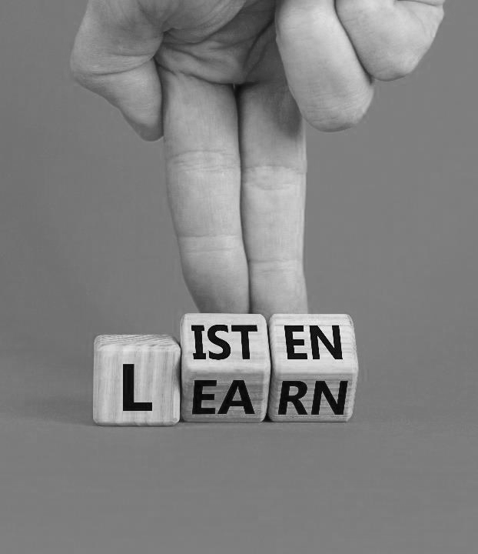
Strategies
Prepare to listen actively
Pay attention to non-verbal cues
Pose open-ended questions
Allow sufficient time for responses
Convey clear messages
Minimize distractions
Notes:
Core Message: We can implement strategies to enhance positive communication.
Say: In behavioral health, we engage with individuals daily about their aspirations and challenges. There are effective strategies to promote positive communication. The first step is to prepare yourself to listen. This may involve taking a moment to breathe to enhance your focus. Remind yourself to be fully present with the individual in front of you and to let go of distractions.
Another effective way to encourage positive communication is to observe the body language of your patient. Do they appear tense, upset, angry, or fearful? This can provide valuable insights into their experience of the situation. It may also indicate that we need to adapt our approach to offer more encouragement, reassurance, or support. Individuals may feel tense, anxious, or distressed during our interactions, which can hinder their ability to express their thoughts and feelings.
Asking open-ended questions is extremely beneficial in behavioral health as it demonstrates genuine interest and can yield valuable information about the individual's behavior.
It also fosters strong relationships, increasing the likelihood that the individual will return for follow-up care.
In behavioral health, we may use jargon, acronyms, or complex terminology. To ensure positive communication, we should convey our messages simply and clearly. We can also ask the individual to repeat what we just said in their own words to confirm their understanding.
Lastly, minimizing distractions is crucial for effective communication. This may involve closing a door or curtain, silencing our phones, and requesting service recipients to do the same, as well as putting away charts or laptops when possible.
Do: Ask the learners:
Which of these strategies do you currently use to facilitate positive communication?
Which of these strategies do you find most challenging to implement?

Slide 9
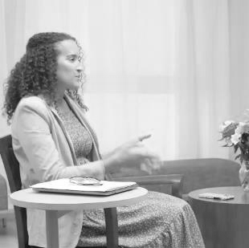

Examples
of Positive Communication
Greet the patient as they enter the room
Organize and put away files and folders
Maintain an open body posture
Acknowledge the patient's situation
Offer support and reassurance
Encourage the patient to ask questions
Notes:
Core Message: Small actions can significantly enhance positive communication.
Say: We've discussed general strategies that promote positive communication. Now, let's explore practical applications. Start by greeting individuals as they enter the room; make eye contact and acknowledge them. Depending on the context, you may choose to shake hands but be mindful of cultural and personal preferences regarding touch. Additionally, putting away unnecessary files or closing your laptop signals to the patient that you are prepared to listen. We will delve deeper into this in future modules, but remember that non-verbal cues, such as avoiding crossed arms and leaning slightly forward, can create a welcoming atmosphere and demonstrate engagement with the patient.
When delivering difficult news or addressing someone who is visibly upset, it is beneficial to verbally acknowledge the situation. For instance, you might say, "I understand this is difficult news to hear," or "I can see that you are upset today." In such moments, offering support, encouragement, and reassurance can be invaluable. Let the individual know that you will accompany them through the next phase of their care and remind them that distress is a common experience that can be overcome with time.
Finally, encourage our service recipients to ask questions. This empowers them and ensures they fully comprehend the situation.
Do: Which of these examples are you most comfortable with? Which ones make you feel uncomfortable?

Slide 10

Barriers (Lime)
Listener
Interlocutor (Speaker)
Message
Environment
Notes:
Core Message: LIME serves as a valuable acronym for identifying barriers to effective communication.
Say: Effective communication is crucial in behavioral health care, yet various obstacles often hinder it. The "LIME" model, which stands for Listener, Interlocutor, Message, and Environment, provides a useful framework for understanding these barriers.
First, consider the Listener. What factors might impede their ability to hear a message? Potential barriers include hearing impairments, distractions, or preoccupation with other thoughts. For professionals, attempting to take notes while conversing can also obstruct effective listening.
Next, examine the Interlocutor. What speaking challenges may arise during communication? Are there language barriers? Has the individual had a challenging day, leading to frustration that affects their communication style?
Then, consider the Message. What are we discussing with the patient? Sometimes, the information we need to convey may be difficult for them to accept, such as sharing bad news or recommending a new treatment. If the message is distressing, the individual may become disengaged and unable to listen.
Finally, reflect on the Environment. What external factors might affect communication? Loud noises in the hallway or an uncomfortable room temperature can be distracting. Consider whether other people, interruptions, or even the presence of a computer for note-taking might hinder open communication.
Do: Encourage individuals to identify barriers specific to their environments.
What common LIME barriers do you encounter in your office?
What challenges do you face as a speaker?
What obstacles do you experience as a listener?

Slide 11

Qualities
of a Good Listener
Reflect on someone in your life who exemplifies excellent listening skills.
What qualities do they possess that make you feel truly heard?
Notes:
Core Message: Effective listening can be demonstrated in various ways.
Say: Listening is an essential skill in behavioral health interactions. There are numerous ways to show that we are truly listening to others. We will explore this topic further, including the steps involved in listening and validating another person. For now, let’s begin by compiling a list of qualities that define a good listener. We will take a few minutes to brainstorm these qualities together.
Do: Engage learners by asking:
Who in your life exemplifies good listening skills?
What actions or words from that person make you feel heard?
Trainer Note: Consider writing the responses on a whiteboard or a large sheet of paper. Afterward, summarize the qualities by category or invite participants to highlight common themes they observe.

Slide 12
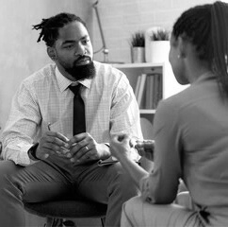
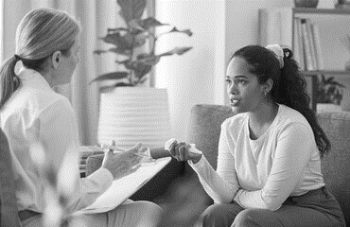
Positive
Communication Qualities
Listen actively
Pay attention to non-verbal cues
Foster relationships
Recognize and address challenges as they arise
Manage your stress effectively
Cultivate cultural awareness
Notes:
Core Message: Effective communication is essential for fostering positive interactions.
Key Points: Positive communication enhances therapeutic relationships through various strategies, including:
Prepare to listen by checking in with yourself. Listening involves giving the speaker your full attention without interruption. Remove distractions, withhold judgments, and avoid arguments. Demonstrate active listening by:
Exhibiting open and positive body language.
Rephrasing or paraphrasing what you’ve heard in your response.
Asking open-ended questions to gather more information.
Pay attention to non-verbal cues, as they provide insight into a person's feelings.
Examples include: Facial expressions, tone of voice, speech rate, body language, and posture.
Take proactive steps to cultivate positive relationships through communication by:
Showing genuine interest, which conveys that the person matters and you wish to understand them.
Using a warm and friendly tone, as it enhances non-verbal communication. Consider how you would like to be greeted by a professional in a supportive environment. Avoid sarcasm, anger, or hostility, as these can damage relationships.
Maintaining a non-judgmental stance. Listening without judgment fosters respect and care, strengthening connections and improving outcomes.
Acknowledge challenges in communication. Misunderstandings are common, and disagreements may arise. For instance, if a person expresses a desire to stop medication due to side effects, it’s important to address concerns without escalating tension.
Suggestions for handling communication difficulties include:
First, validate the person's thoughts and experiences. Acknowledge their perspective by saying something like, "I understand why you feel that way." The goal is to recognize their viewpoint, not to correct it.
Agree to disagree if necessary. If the conversation reaches a point of disagreement, it’s acceptable to acknowledge differing opinions while emphasizing your commitment to their health.
Manage your stress levels. Behavioral health providers must be aware of their own stress, as it can affect emotional regulation and the ability to support patients effectively.
Strategies include regularly checking in with your emotions throughout the day and engaging in self-care routines to maintain well-being.
Be mindful of cultural communication preferences. Start by asking patients how they prefer to be addressed. Recognize that cultural differences exist, such as varying views on eye contact. Educate yourself about your patients' cultural backgrounds to enhance communication.
your own.

Slide 13


Cultural and Disability Considerations
Recognize and accommodate individual communication needs
Understand your cultural background and communication style
Respect preferences for communication
Use clear and simple language
Allow extra time for communication
Encourage feedback and seek clarification
Practice empathy in interactions
Notes:
Core Message: We can enhance communication with individuals from diverse cultural backgrounds.
Say: Effective communication with those who differ from us requires intentional use of our listening skills and attention to various factors. First, recognize potential challenges in communication, such as hearing difficulties, cognitive processing styles, and language barriers. Next, understanding your own culture and communication style is crucial, as communication is a two-way process. Taking time to explore the communication preferences of other cultures can be beneficial. When interacting with someone from a different cultural background, it is important to use simple language, avoiding jargon and slang. Additionally, consider the individual's literacy level and their capacity to comprehend complex language.
It is also essential to allow extra time for the person to fully grasp the information being conveyed. Pausing after asking a question can provide the individual with a moment to formulate their thoughts. Individuals with mental health conditions may require more time than those without such conditions to process and respond.
Another effective strategy is to invite feedback and clarification from your client (e.g., summarize your understanding of what they are saying and ask for confirmation). This approach encourages questions and reinforces the retention of new information.
Lastly, employing empathy can help you understand how the individual is experiencing the interaction.
Do: Encourage learners to share their unique communication preferences and cultural styles with one another. Then, ask learners to discuss how these preferences or styles may facilitate or hinder positive communication.
Say: For instance, some individuals prefer written communication, while discussing feelings may be more challenging for them. Additionally, some cultures view a handshake as a sign of respect, whereas others may find it uncomfortable.

Slide 14

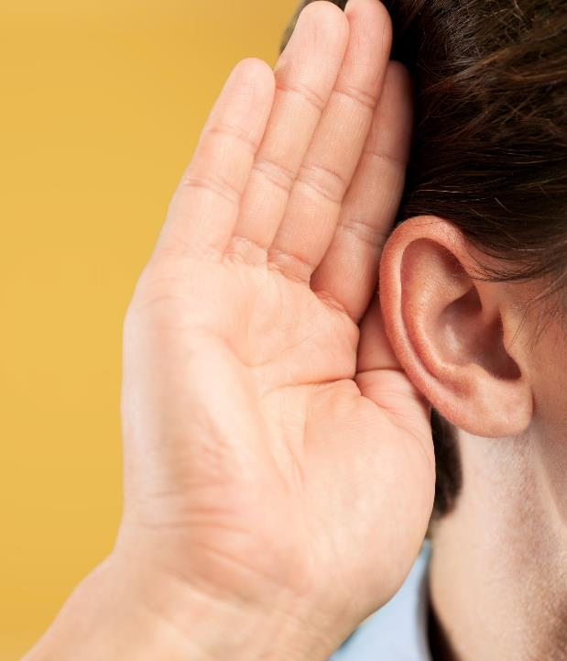
Engaging Others
Utilize open-ended questions to encourage deeper thinking
Explore individual interests and aspirations
Provide options to foster
decision-making
Demonstrate respect and instill hope
Identify and acknowledge strengths
Notes:
Core Message: Behavioral health providers can implement strategies to enhance engagement, fostering a stronger connection with those they serve.
Say: Behavioral health providers depend on their ability to connect with individuals to effectively communicate information. This is often referred to as "engagement skills," encompassing the communication and social skills that facilitate motivation, cooperation, and learning. In our work environments, we interact with diverse individuals and must cultivate positive relationships with our service recipients.
Providers frequently engage with individuals experiencing acute distress or who may not fully grasp the purpose of their visit. For instance, a service recipient might be referred by their primary care provider without understanding the reason for their appointment. They may also feel upset or frustrated about needing services at this time.
In such situations, behavioral health providers may need to employ additional communication techniques to effectively engage the individual (e.g., engagement strategies).
Now, let’s explore some examples of engagement strategies.
Open-ended questions, which encourage further conversation, can demonstrate genuine interest in the individual. They are also effective for gaining deeper insights into the person. Questions beginning with “What” or “How” are particularly useful for establishing connections. For example, you might ask, “How are things going for you?”
Another effective engagement technique is to inquire about the individual’s interests or future aspirations. Understanding more about the person can enhance your ability to support their learning and motivation for change. A simple way to initiate this is by asking, “Tell me about yourself; what do you enjoy doing?”
Offering choices is another strategy to foster connection. This can be as simple as asking where the individual prefers to sit or which topic they would like to discuss first. Allowing individuals to make choices empowers them and conveys respect.
Behavioral health providers can also express respect and hope for the individual, which strengthens connections. Respect can be shown by listening attentively, using the person’s preferred name and pronouns, and refraining from interruptions. Communicating hope for their recovery and improvement can be profoundly impactful for those seeking help. Research indicates that when providers express hopefulness, it correlates with better health outcomes.
Finally, identifying and acknowledging an individual’s strengths during interactions can be beneficial. Highlighting their resilience and capabilities serves as a reminder of their potential to overcome challenges and can enhance the relationship.
Ask: Encourage learners to discuss the significance of engagement skills in their respective settings. As you collect responses, draw comparisons between different environments and highlight any unique aspects mentioned. Remind learners that employing engagement skills is a crucial component of work in behavioral health care.
Encourage learners to discuss the significance of engagement skills in their respective settings. As you collect responses, draw comparisons between different environments and highlight any unique aspects mentioned. Remind learners that employing engagement skills is a crucial component of work in helping professions.

Slide 15

LIME for Positive Communication
Listener
Allow time for response
Check-in with yourself
Interlocutor (Speaker)
Focus communication on the individual
Message
Some topics may require more time and support
Environment
Be aware of noise, privacy and distractions
Notes:
Core Message: The LIME acronym serves as a valuable reminder of strategies for effective communication.
Say: Previously, we discussed communication barriers using the LIME model, which stands for Listener, Interlocutor, Message, and Environment. We can apply the same LIME model to identify strategies that promote positive communication. Let’s explore the four categories with practical ideas to enhance communication with those you support.
Starting with the Listener: It is crucial to consider your audience and their specific needs during communication. Individuals who are upset, anxious, speak English as a second language, or have disabilities may require extra time to process the information. Those with serious mental health conditions may also need additional time to comprehend your message. To encourage positive communication, allow ample time for responses and questions. Reflect on your own state as a listener. Are you fatigued or distracted? Have you set aside your phone? Prepare yourself to listen actively. If you are not at your best, taking a deep breath can help refocus your attention on the conversation.
When interacting with the individual you are assisting, it is essential to direct your attention to them. Often, service recipients are accompanied by caregivers, parents, or healthcare workers. To foster meaningful engagement, ensure that you speak directly to the person you are supporting. Additionally, consider using open-ended questions, allowing sufficient time for responses, and striving to communicate your messages clearly.
Focusing on the message you are conveying is essential. When delivering unfavorable health news, it is important to approach the situation with sensitivity. You may need to invest additional time or provide extra support to those receiving the bad news.
Trainer Notes: Keep in mind that the LIME factors may vary with each interaction. You may be experiencing a good or bad day, the person you are meeting with may be in a similar situation, you may need to deliver difficult news, or the meeting environment may be uncomfortable. LIME provides a framework for striving towards more positive communication.

Slide 16

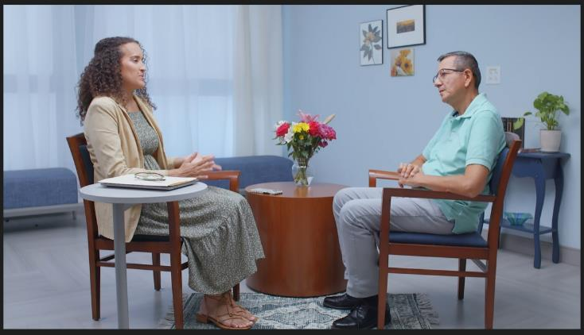
Video: Mental Health M01 LIME
Notes:
Show video. Before the video begins ….
Say:
In this video, we will observe Dr. Aubrey Daniels interacting with Peter. Please pay close attention to the practitioner’s non-verbal actions that foster a welcoming environment. Additionally, observe the client’s non-verbal communication and reflect on the emotions they may be experiencing. Finally, note how the practitioner effectively creates a welcoming space.
I will also ask you to consider the LIME barriers to positive communication: Listening, Interlocutor or Speaker, Message, and Environment. Can you identify any examples of LIME barriers that were addressed during the interaction?
https://youtu.be/yd6Ir1F8OIs

Slide 17

1
Summary
Positive communication is necessary in helping situations.
Communication includes listening, respect, awareness of self and attending to culture and disability.
LIME (Listener, Interlocutor, Message and Environment) can help us to overcome potential communication barriers.
“
  LIME (Listener, Interlocutor, Message and Environment)
“
Notes:
Core Message: Effective communication involves actively engaging with the individual, listening attentively, and taking deliberate steps to foster interaction.
Overview: This module focuses on the essential elements of positive communication in helping professions. By listening, showing respect, acknowledging cultural differences, and being self-aware, we create an environment conducive to effective communication. The LIME model serves as a valuable tool for navigating potential challenges during interactions.
Trainer Notes: Encourage participants to ask questions. Additionally, invite learners to share their key takeaways from today's session. Thank them for their active participation.

Slide 18
1
In Practice
Recognize when you are listening attentively without distractions.
Acknowledge how you demonstrate respect in conversations.
Observe how you engage with a person's cultural background and disabilities.
Utilize LIME to address potential communication barriers.
Notes:
Core Message: Effective communication involves actively engaging with the individual, listening attentively, and taking deliberate steps to foster interaction.
Overview: This module focuses on the essential elements of positive communication in helping professions. By listening, showing respect, acknowledging cultural differences, and being self-aware, we create an environment conducive to effective communication. The LIME model serves as a valuable tool for navigating potential challenges during interactions.
Trainer Notes: Encourage participants to ask questions. Additionally, invite learners to share their key takeaways from today's session. Thank them for their active participation.

Slide 19

Grant # 1H79SM081783
Notes:
Funding for this project was from the Substance Abuse and Mental Health Services Administration.
Grant# 1H79SM081783
More info:
Dr. Ann Murphy
murphyaa@shp.rutgers.edu

