Slide 1

FOUNDATIONAL COMMUNICATION SKILLS
Mental Health Setting
Notes:
Say: Welcome to this training series on foundational communication skills: mental health setting. The series contains three modules, Module 1: Positive Communication and Barriers to Communication; Module 2: Active Listening Skills; and Module 3: Putting it All Together: Applying Communication Skills in Your Setting.
This training program will provide a balanced approach, combining informative content, observations of skills in action, and opportunities for you to practice and apply these skills in your own environment.
Trainer note: This series is a total of approximately six hours. Module 1 has been designed to be approximately 90 minutes, Module 2 has been designed to be about 3 hours, and Module 3 has been designed to be about 90 minutes.

Slide 2

In Conjunction With

Slide 3


Presents

Slide 4

2
Active Listening Skills
Mental Health Setting
Notes:
Say:. Having explored the significance of positive communication and the ways to minimize communication barriers, we will now focus on developing active listening skills.

Slide 5

2
Review Activity
Following our last session, your tasks were to:
1. Identify when you are listening without distractions
2. Observe how you show respect in conversations
3. Note how you acknowledge a person's culture and disability
4. Use LIME to address communication barriers
How did it go?
Notes:
Core Message: Processing learning application
Say: Following your last session, you were encouraged to implement some strategies from Module 1. Focus on observing your listening habits, noting when you are distracted versus fully engaged. Reflect on how you demonstrate respect towards clients and make note of your efforts to address cultural and disability considerations. How did you applied the LIME framework in one of your interactions?
Do: Ask the group to get into pairs to briefly (no more than 4 minutes total) share their thoughts and experiences in response to the points on the slide.

Slide 6

Objectives
01
02
03
Describe active listening and why it is important
Define non-verbal communication
Discuss and Practice:
Open-Ended Questions
SOLER and Non-Verbal Communication
Reflective Responding
Notes:
Core Message: Agenda for the Active Listening Module
Say:
Today, we will explore Active Listening Skills. We will define active listening and discuss its significance.
Our discussion will include non-verbal communication. We will practice effective non-verbal cues and apply SOLER skills. Additionally, we will learn to interpret others' non-verbal signals.
We will also examine the use of open-ended questions and their advantages.
Finally, we will discuss reflective responding, focusing on the three main types: content responses, feeling responses, and meaning responses.
Do:
Trainer notes:

Slide 7

2
What is Active Listening?
Building Positive Communication (LIME)
  Prioritize the individual and the communication process
  Minimize distractions
  Be attentive to the individual's words, actions, and emotions
Employing evidence-based counseling techniques
Notes:
Core Message: Active listening encompasses a set of evidence-based skills that helping professionals can utilize to connect more deeply with individuals.
Say:
Active listening is a communication strategy that prioritizes our attention on the individual we are assisting.
Active listening requires a deliberate effort to engage with the person you are communicating with and to comprehend the message they are conveying. There are various methods to exhibit active listening.
Be aware of LIME (Listener, Interlocutor, Message, and Environment) and the challenges that may arise during communication, as well as the potential barriers we have previously discussed (client, family member, student, etc.).
Concentrate on what the individual is saying, doing, and feeling.
Reduce distractions in the environment.
Employ evidence-based skills that enhance the interaction with the individual in front of you. We will explore these further later, but examples of evidence-based communication skills in healthcare include attending to body language, asking open-ended questions, using reflective statements, and responding to emotions.
Do:
Ask Learners
How can you tell that someone, such as a healthcare provider, is listening to you? (What are some behaviors that indicate they are listening?)
Examples to consider: providing verbal and non-verbal affirmations, facing you, maintaining eye contact.
Review LIME
L - Listener
I - Interlocutor (Speaker)
M - Message
E – Environment
Why is listening crucial in counseling settings?
To comprehend the information being shared with you.
To demonstrate to the individual that you are listening and that their message is significant.
Trainer notes:

Slide 8

Open-Ended Questions
Encourages the person to have a richer discussion
Avoid asking Closed-Ended Questions
With Yes, No, or Short Answers
  Closed Ended Question
  “Was your weekend good?”
  Open Ended Question
  “Tell me about your weekend.”
Notes:
Core Message: Open-ended questions invite information sharing and foster richer discussions.
Say:
Open-ended questions elicit more detailed responses from clients and typically begin with "What" or "How." These questions encourage individuals to share more information, leading to deeper discussions.
When asking open-ended questions, prioritize listening over speaking.
Allow sufficient time for the person to respond before posing another question, as individuals with mental health conditions may require extra time to process or reply.
Avoid closed-ended questions.
Closed-ended questions are questions that can be answered with "Yes," "No," or a brief response.
These limit the respondent's options and provide minimal information.
While closed-ended questions may be necessary at times, their overuse in healthcare can make clients feel interrogated and defensive.
Do:
Discuss examples of open and closed-ended questions.
Ask learners what information they might gather from each type of question.
Examples to consider:
"Tell me about your weekend" vs "Was your weekend good?"
"Tell me about your mental health these days" vs "Do you consider yourself to have good mental health?"
Discuss the differences in potential responses.
Encourage learners to share their own examples of open-ended questions.
What would be a good open-ended question to determine:
The person's treatment goals?
How family could provide support?
What they appreciate about their current treatment?
Trainer notes: Discussing how to frame open-ended questions can be beneficial. For instance, "What" and "How" questions are effective for eliciting responses, while "Why" questions (e.g., "Why did you do that?") may come across as critical and risk shutting down the conversation.

Slide 9

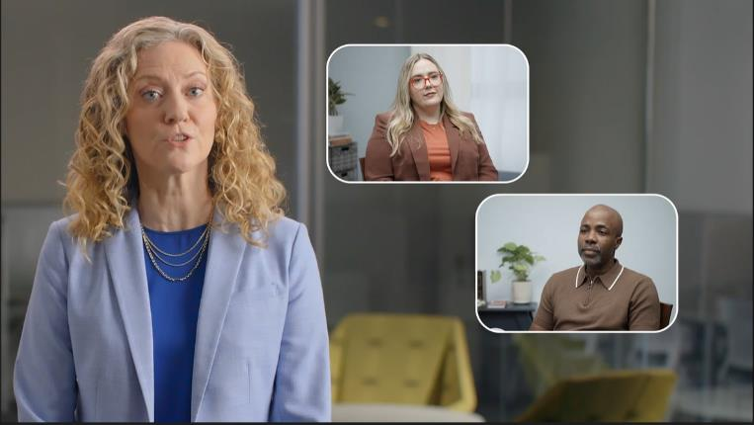
Video: 02_Mental Health Setting Module 02_OPEN ENDED QUESTIONS
Notes:
Core Message: Effective methods for asking open-ended questions can significantly enhance communication.
Say:
Let’s examine an example featuring a provider named Crystal, who uses open-ended questions to understand how she can best assist Earle, a service recipient.
Pay attention to ….
The use of open-ended questions
The responses to these questions and the level of detail provided
Do:
Watch the video on open-ended questions.
Ask Learners …
What open-ended questions were used in the video?
How did the individual respond to those questions?
In what ways might closed-ended questions influence the conversation?
What open-ended questions would you have asked in this scenario?
https://youtu.be/a768u1o6yD4

Slide 10
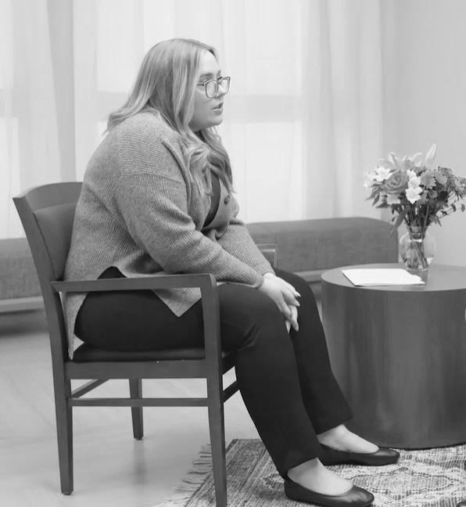
Non-Verbal & SOLER Skills
Conveys we are listening and actively engaged in the conversation.
  S - sitting squarely, facing the person
  O- open posture
  L - lean forward to show we are interested in what the person is talking about
  E – eye contact
  R – relaxed body language
Notes:
Core Message: Utilizing SOLER and non-verbal communication skills indicates our attentiveness to the individual we are conversing with.
Say:
Our body language plays a crucial role in conveying that we are listening and actively engaged in the conversation.
Employing evidence-based SOLER skills effectively communicates our attentiveness and willingness to listen.
SOLER stands for:
Squaring – refers to positioning yourself squarely with the person you are speaking with.
Ensure you are facing the individual with your shoulders aligned towards them.
This demonstrates your focus on the person.
Open Posture – signifies maintaining an open body posture while facing the other person.
Your arms and legs should ideally be uncrossed, as crossed limbs can create a barrier between you and the speaker.
An open body posture fosters a welcoming environment.
Leaning – involves angling your body slightly forward.
This action indicates interest in what the speaker is saying.
While leaning is beneficial, be mindful of personal space and cultural preferences.
Eye Contact – entails looking into the other person's eyes during conversation.
While maintaining eye contact is essential, excessive eye contact can feel intense and unnatural.
Briefly looking away and blinking regularly can make eye contact feel more natural.
One suggestion is to occasionally shift your gaze above the person or over their shoulder.
Be considerate of the individual's cultural background and preferences regarding eye contact.
Relaxed – means to physically and mentally calm yourself and feel comfortable in your space.
Some aspects of SOLER may feel unnatural; remembering to relax can help ease this discomfort.
Creating a relaxed atmosphere contributes to a welcoming and safe environment.
Remember to take deep breaths when interacting with someone.
Do:
Engage learners:
Let’s discuss your thoughts on the impacts of these five areas.
Sitting Squarely - how does it feel when someone is facing you during a conversation?
Open Posture – how does it feel when a person has an open versus closed body posture?
Leaning – how does it feel when someone leans towards you while speaking?
Eye Contact – how does it feel when someone maintains eye contact with you during conversation?
Relaxed – how does a person with a relaxed presence affect your feelings?
Trainer Notes:

Slide 11
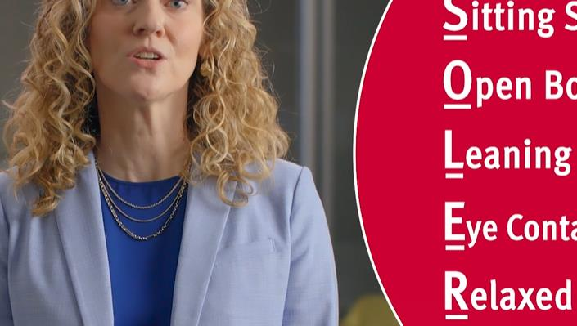
Video: 04_Mental Health Setting Module 02_SOLER
Notes:
Core Message: Understanding the significance of non-verbal SOLER communication skills is essential for effective health communication.
Say:
Let’s observe another interaction between Crystal, our provider, and Earle, the service recipient.
Pay attention to Crystal’s non-verbal characteristics:
- Her sitting position
- Eye contact
- Body language
- Facial expressions
Do:
Show the SOLER video.
Say:
After the video, ask the learners:
- What positive non-verbal behaviors did you observe from Crystal, the provider?
- When engaging with someone, be mindful of the messages conveyed through your body language.
- How can you apply SOLER skills in your own environment?
Trainer notes:
https://youtu.be/vUPl6GKT1k0

Slide 12



Examples
of Non-Verbal Communication
When working with someone, consider:
  Their attire and grooming
  Eye-contact
  Facial expressions
  Body language
  Tone of Voice
Notes:
Core Message: Effective communication extends beyond spoken words.
Say:
Our understanding of collaboration is shaped not only by verbal exchanges but also by non-verbal cues.
Observing others' non-verbal communication is equally crucial as being aware of our own.
When collaborating with others, consider …
Attire and grooming - What is their clothing like? Is it clean and appropriate?
Eye contact - Are they maintaining appropriate eye contact? Is it excessive or insufficient?
Facial expressions - Do their facial expressions align with the topic of discussion?
Body language - Are they facing you and engaged? Does their body language convey emotions that differ from their words?
Tone of voice - The manner in which things are said is also significant.
Do:
Review the photo examples on this slide illustrating non-verbal communication.
Discuss with learners what messages these examples might convey if they were your client.
Say:
Here are some examples of non-verbal cues we may encounter: someone may be holding their head or appear upset. Their tone of voice might be breathless or loud. They may struggle to maintain eye contact.
What messages are they conveying through their body language?
Trainer notes:

Slide 13


Reflective Responding
An evidence-based practice using formulated responses to talk with a person.
These include:
  Content Responses
  Feeling Responses
  Meaning Responses
Notes:
Core Message: Reflections help ensure that the person you are communicating with feels heard and provides an opportunity to correct any misunderstandings.
Say:
Reflective responding involves verbally engaging with a person in a specific manner.
This communication skill is an evidence-based practice that employs structured responses to enhance engagement with those we support.
Today, we will explore three types of communication skills:
Content Responses
Feeling Responses
Meaning Responses
Utilizing reflective responding encourages the individual we are working with to share more.
This approach allows us to gather more information and gain deeper insights into their thoughts and feelings.
This enhanced understanding can reveal their goals and motivations for achieving those goals.
Do:
Inquire if learners have previously used these skills or if they are familiar with them to assess their understanding of these concepts.
Trainer notes:

Slide 14

Content Responses
A response to the person about the main points the person is talking about.
Benefits:
Ensures we understand what
was said
Allows the person to rehear what they said
Communicates to the person you are listening
Notes:
Core Message: Content responses involve directly addressing the words spoken by an individual.
Say:
The first technique is to respond directly to the words spoken by the individual. This is known as content responses.
This skill allows us to capture the main points being discussed. In other words, what are the key elements the individual is expressing?
Reflections are statements and should not begin with question words such as who, what, where, when, how, or why.
Utilizing the content responding skill offers numerous benefits for us as providers.
First, it encourages the individual to share more. The more we engage the person in conversation, the more information we can gather.
Our understanding of the individual improves.
Second, it allows us to verify our understanding of what has been said. We may not always accurately capture our content responses and might focus on less significant points. This is acceptable, as the individual will correct us and likely clarify the information.
Third, it helps build rapport. By responding to the content of what is said, we demonstrate that we are actively listening. It conveys to the individual, “I am here, paying attention to everything you are saying.”
Fourth, it allows the individual to hear their own words. By reflecting back what they have said, they can reconsider their ideas and expressions.
In counseling, this can be beneficial for the individual to reflect on their thoughts and how they articulate them.
Let’s explore content responses in greater detail.
Trainer notes:

Slide 15

Content Responses – A Closer View
Rephrase the speaker's message
Be concise yet specific
Utilize original phrasing; avoid repetition and maintain a
non-judgmental tone
Refrain from interpreting the original statement
“You’re saying ______________.”
“You’re saying you are going to the sporting event.”
Notes:
Core Message: Content responses serve as a reflective technique to capture and clarify the information conveyed by the speaker.
Say:
To effectively use this skill, after the speaker has finished, respond with, “You are saying … ” followed by a summary of their main points.
Initially, using content responses may feel challenging and awkward, as it represents a departure from our typical communication style.
Here are key points to enhance the effectiveness of reflective responding: You are reflecting the speaker's message, acting as their mirror; however, avoid repeating their words verbatim, a practice known as parroting. The goal of content responses is to paraphrase the speaker's message using different words. Strive to be concise yet specific enough to encourage the speaker to continue sharing.
Trainer notes:

Slide 16
Other Content Phrases To Try ….
“Sounds like….”
“What I heard you say is….”
“Let me get this straight,….”
“So, if I heard you correctly….”
“So, what you mean is…”
Can you think of others?
Notes:
Say:
The fundamental formula for content responses is "So you are saying." However, there are various ways to initiate our content responses.
On this slide, you will find examples of basic "starters" for reflections. While these may differ, they convey the same message and can all be effective.
Keep in mind that reflections are statements; therefore, they should not begin with question words such as who, what, where, when, how, or why.
As you become more comfortable using these starters, feel free to substitute your own if they better suit your work environment. For now, these provide a solid foundation for crafting simple reflections.
Do:
Ask learners:
What additional starters for reflections can you think of?
Which of these do you think you might use?

Slide 17


An Example
“Today was a good day. I went to the park for a walk in the park with my friend. We saw some geese and some people fishing down by the lake. I was really happy that the sun was out. We made plans to do it again next week.”
Looking at this statement closer …
  What are the main points being discussed?
  What would a good content response be?
Notes:
Core Message: Content responses are reflective skills aimed at understanding an individual's experience.
Say:
Let’s examine an example of a statement from the person we are assisting.
What are the main points the person is expressing?
Do:
Discuss the example and explore potential content responses with the learners.
Trainer Notes:
Here is an example of an appropriate feeling response if needed:
“You’re saying you enjoyed the trip to the park with your friend.” (Good response)
“It sounds like you enjoyed the trip to the park with your friend.” (Good alternative response)

Slide 18
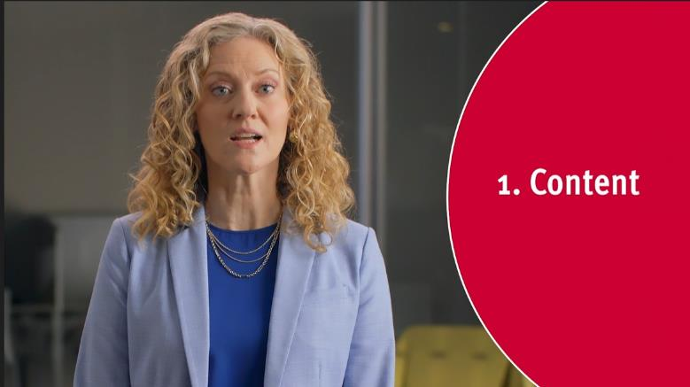
Video: 03_Mental Health Setting Module 02_REFLECTIVE RESPONDING (Content Section)
Notes:
Core Message:
Say:
Let’s observe an interaction that demonstrates the use of content reflections. In this video, pay close attention to how Crystal, the provider, employs content skills, structures her communication, and how Earle responds.
As you watch the video, listen for and identify the following:
The formula used for content reflection
Phrases such as “So you are saying…” and other starters employed by Crystal
SOLER skills demonstrated by the healthcare provider
Earle’s non-verbal communication and its possible implications
Do:
Watch the Reflective Responding skills video. Stop after the content response section. (Note that different sections of this video will be used throughout the module).
After the video, engage in a class discussion.
Evaluate the effectiveness of the responses and the different formulas used.
Introduce SOLER skills.
Discuss Earle’s non-verbal communication and its potential meanings.
Trainer Notes:
For additional practice, divide into small groups and take turns using content responses during communication interactions. Learners can discuss:
their day, positive experiences from the past week, or something they are looking forward to in the coming month.
VIDEO:
Special note: There will be moments in the video where you can pause and discuss each type of response, starting with content.
https://youtu.be/dJZoYUeo3J8
STOPPED HERE

Slide 19

Feeling Responses
Builds upon the content regarding emotions, focusing on the impact of experiences and feelings about sharing information.
Direct –
The individual explicitly expresses their feelings
Indirect –
Feelings can be inferred from behaviors, body language, facial expressions, and tone of voice
“You feel ______________.”
Notes:
Core Message: Feeling responses can convey both direct and indirect messages.
Say:
The next level of reflective responding involves feeling responses, which build upon content responses.
Feeling responses focus on understanding the emotional impact of the person's experience. We aim to capture how the individual feels about the information they are sharing.
When someone is speaking with us, we must listen for statements or cues that reveal their feelings.
The individual may express their feelings using direct words or indirect, non-verbal cues.
Direct
The person may directly articulate their feelings, often using specific feeling words.
Example: “Today I saw my sister, which made me happy.”
Indirect
The person may not explicitly state their feelings. We need to interpret other cues, such as behaviors, body language, facial expressions, and tone of voice.
Example: “It’s fine really, it was just a silly game we lost.” <the person has their head down and exhibits closed body language>
The structure of this skill is as follows:
After the person has spoken,
We respond with “You feel”
And then articulate a word that encapsulates their feelings.
Do:
Trainer notes:

Slide 20
Matching Feeling and Intensity
Level of Intensity | Happy | Sad | Angry | Confused
High | Excited | Depressed | Furious | Bewildered
Medium | Cheerful | Upset | Frustrated | Mixed-Up
Low | Glad | Down | Annoyed | Undecided
Notes:
Core Message: It is essential to match both the type and intensity of feelings in communication.
Say:
When responding to feelings, it is important to use different feeling words than those expressed by the other person. Similar to the content response skill, we should avoid repeating the person's words. To accurately reflect their emotions, we must MATCH both the type of feeling and its intensity.
On this slide, you will find examples of various types and intensities of feelings.
Do:
Review the Feeling Work Chart included in the supplemental materials with your learners. A few samples from that chart are provided here.
Ask learners to pair up for a brief activity. Each pair should share one positive or negative experience they are comfortable discussing with the larger class or group. One person will act as the listener, reflecting back the feeling word with the appropriate intensity based on what the speaker shared. Before switching roles, have them discuss whether the listener accurately reflected the feeling and its intensity. After switching, repeat the activity. Reconvene as a larger group and invite a few volunteers to describe their experiences and whether the feelings and intensities were accurately reflected.
Trainer Notes: This activity should be brief. Limit the pairing time to five minutes and allocate about three minutes for group processing.

Slide 21
An Example
“We are planning to go back to the park next week. I’m glad to go back and enjoy the day with my friend.”
How if this person feeling?
What might be a good feeling response?
What are some other feeling words that match the type and intensity?
Notes:
Core Message: Feeling responses are a reflective skill aimed at understanding the emotional impact of a person's experience.
Say:
Here is an example of a statement from a person we are assisting. How do you think this person is feeling?
Do:
Discuss the example and explore potential feeling responses with the learners. Encourage them to suggest different words that might accurately describe how the person is feeling.
Trainer Notes:
Here is an example of an appropriate feeling response, if needed:
“You feel happy.” (This is a suitable feeling word match.)

Slide 22
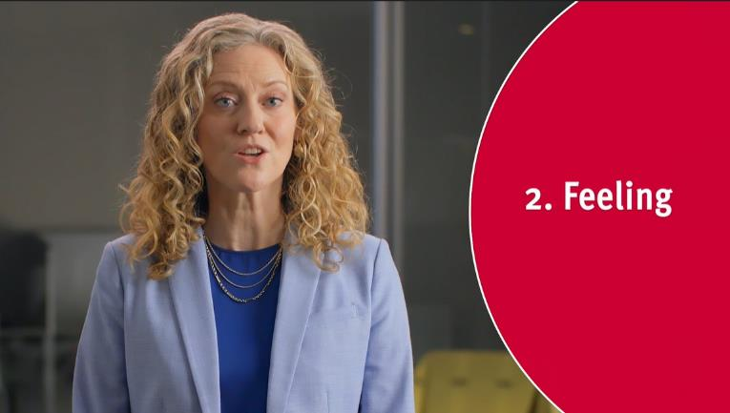
Video: 03_Mental Health Setting Module 02_REFLECTIVE RESPONDING (Feeling Section)
Notes:
Core Message: Observing the use of feeling skills can enhance practice of these skills.
Say:
Let’s continuing watching our last video demonstrating reflective responding, picking up with feeling skills as used by Crystal.
While watching, let’s focus on:
How Crystal applies the feeling skill formula
The type and intensity of the words used
Earle’s direct and indirect feeling clues and language
Crystal’s SOLER skills as the provider
Do:
Continue playing the Reflective Responding skills video at the Feeling skills section. ((approx. 3:06) Stop the video at the end of this section.
After the video, engage in a discussion with the learners about:
The feeling skill formula
The type and intensity of the words used
The direct and indirect feeling clues and language used by Earle, the person receiving help
Discuss Crystal’s SOLER skills as the provider
Trainer notes:
For additional practice, divide into small groups and take turns discussing and demonstrating feeling responses.
Learners can discuss:
Their day
Something positive that happened in the past week
Something they are looking forward to in the next month
https://www.youtube.com/watch?v=dJZoYUeo3J8

Slide 23
Meaning Responses
“You feel excited because of the upcoming sporting event.”
Connection of the content and the feeling in one response
To Review:
Content: clarify the ingredients
Feeling: clarify the effect attached to the experience
Meaning responses: clarify the reason for the feeling
Notes:
Core Message: Meaning responses integrate both feelings and content into a single response.
Say:
We have previously discussed content and feeling responses. Content responses clarify the key elements of what the individual we are assisting has expressed.
We provide a concise summary using original language, ensuring we do not simply repeat the individual’s words.
Feeling responses clarify the emotional impact associated with the experiences discussed by the individual. Use original language to convey the feeling, ensuring it aligns with the appropriate category and intensity.
We will now transition to meaning responses. Meaning responses connect the content and the emotional aspects of the content in a single response. This is the most comprehensive type of response in active listening. We utilize the content to clarify and enhance the meaning of the feelings expressed, aiming to stimulate and support the client’s exploration of their experiences.

Slide 24
Meaning Response Principles
Do NOT say “You feel like or that __...”
Do NOT say “You feel ____ because you …”
Say – “You feel upset because the baseball game is tonight.”
Notes:
Core Message: Meaningful responses should center on the individual's expression.
Say:
An essential aspect of meaningful responses is to avoid focusing the content on the individual. The emotion you respond to reflects how the person is feeling. However, the content should pertain to a different person, place, or thing.
Avoid using “you” in the second part of the sentence, as the feeling pertains to another person, place, or thing, rather than the individual.
Focusing the content on the individual is a different, more advanced skill known as personalizing.

Slide 25

An Example
“We are going to explore a new part of the park we saw before we left. It should be great! We thought we say a path that eventually overlooks the whole lake.”
How is this person feeling?
hat is the content the person is saying related to the feeling?
What may be a good meaning response that connects the feeling and meaning?
Notes:
Core Message: Feeling responses are a reflective skill aimed at understanding the emotional aspects of a person's experience.
Say:
Here is an example of a statement from the individual we are assisting. Let’s collaboratively create meaningful responses that reflect their words.
Do:
Examine the example and explore potential meaningful responses.
Engage with learners by discussing examples of meaningful responses.
Encourage them to identify the content and emotional components of the meaningful responses.
Trainer Notes:
Here is a good example of a meaningful response:
“You feel excited because there is a new part of the park to explore.” (This captures both the emotion and the content effectively.)

Slide 26
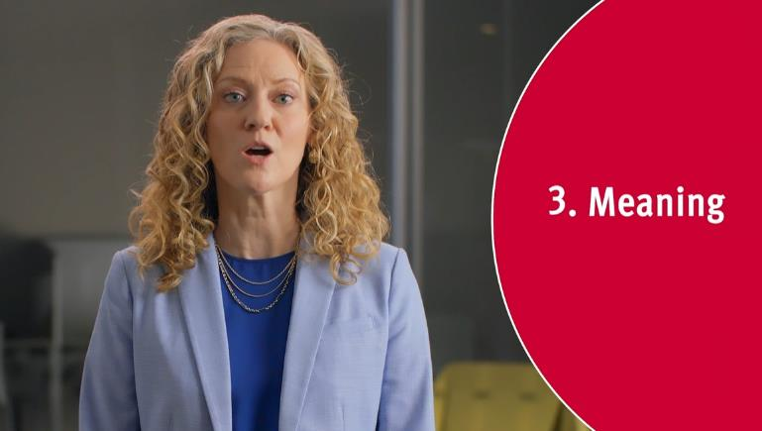
Video: 03_Mental Health Setting Module 02_REFLECTIVE RESPONDING (Meaning Section)
Notes:
Say:
Let’s continue with our video, focusing on the use of meaning reflections.
Observe how Crystal, the provider, employs the meaning skill, the structure of this skill, and Earle's responses.
Pay attention to…
The formula of the reflection
The phrase structure: “You feel _____ because _______…”
The type and intensity of the feeling words used
Earle’s direct and indirect feeling clues and the language he employs
Let’s also examine Crystal’s SOLER skills
Do:
Watch the Reflective Responding video, picking up at the Meaning section (approx. 4:22). After the video discuss with the class ….
The effectiveness of the responses
The meaning skill formula
The type and intensity of the words used
The direct and indirect feeling clues and language Earle employs
Discuss Crystal’s SOLER skills
Trainer notes:
For additional practice, divide into small groups and take turns practicing meaning responses.
Learners can discuss:
Their day
Something positive that occurred in the past week
Something they are looking forward to in the next month
https://youtu.be/dJZoYUeo3J8

Slide 27

2
Summary
Active Listening encompasses essential skills for effective communication.
The objectives are:
To encourage individuals to express themselves freely and feel valued.
To enhance understanding of others for more effective communication.
“
  Encouraging individuals to express themselves freely and enhancing understanding of others for more effective communication.
“
Notes:
Core Message: Active listening enhances engagement and fosters positive communication among behavioral care providers.
Say:
Active listening encompasses a set of skills that support our interactions with those we assist.
These skills include non-verbal techniques, such as SOLER, and recognizing the non-verbal cues of those we are helping.
Verbal skills are also essential, including Open-Ended Questions, Content Responses, Feeling Responses, and Meaning Responses.
Do:
Encourage learners to share their questions and insights and ask them to identify the most helpful and impactful aspects of this module.
Trainer notes:
Additional practice is beneficial for skill acquisition. Consider dividing learners into small groups for further skill practice.

Slide 28
2
In Practice
Before our next session/class:
Use SOLER, open ended questions, and content, feeling, and meaning reflections with a client. Notice how the client responds to you.
Notes:
Core Message: You can practice new communication skills in your own setting.
Say:
We've gone over many skills that could help you with your appointments with patients. Between today and the next time we meet I'd ask that you try out some of the strategies. For example, use SOLER, open-ended questions, and reflections with patients. Notice how the patient responds to you. Next time we meet, I'll ask you to share your thoughts and experiences.
Trainer note: If the learners will not be able to meet with a client before next session/class, ask them to practice using the skills with a friend or family member.

Slide 29

Grant # 1H79SM081783
Notes:
Funding for this project was from the Substance Abuse and Mental Health Services Administration.
Grant# 1H79SM081783
More info:
Dr. Ann Murphy
murphyaa@shp.rutgers.edu

