Slide 1

FOUNDATIONAL COMMUNICATION SKILLS
Mental Health Setting
Notes:
Say: Welcome to this training series on foundational communication skills in a mental health setting.
This series consists of three modules:
Module 1: Positive Communication and Barriers to Communication
Module 2: Active Listening Skills;
and Module 3: Putting it All Together: Applying Communication Skills in Your Setting
This training will provide a balanced approach, combining information, observations of skills in action, and opportunities for you to practice and apply these skills in your own environment.
Trainer note: This series lasts approximately six hours. Module 1 is designed to take about 90 minutes, Module 2 is approximately 3 hours, and Module 3 is also about 90 minutes.

Slide 2

In Conjunction With

Slide 3


Presents
Notes:
Logos and animation to match video.

Slide 4

3
Putting It All Together
Mental Health Setting
Notes:
Say: We have discussed the significance of positive communication and how to minimize barriers. Now, let's focus on developing our active listening skills.

Slide 5

3
Review Activity
What positive communication barriers are specific to your practice setting?
What questions do you have about Module 1 and Module 2?
Has anyone had the chance to apply SOLER, open-ended questions, and content, feeling, and meaning reflections with a client?
Notes:
Core Message: This session will focus on reviewing previous modules and discussing the challenges or obstacles trainees face when implementing and applying the concepts in their own settings.
Say: Let's take some time to review Modules 1 and 2.
We will begin by discussing positive communication and the barriers to communication, particularly those that are unique to your practice setting. Following that, we will review active listening techniques, including SOLER, open-ended questions, and the reflections you learned in Module 2.
Before we proceed with our review, what questions do you have regarding Modules 1 and 2? Is there any information that remains unclear? Has anyone had the chance to practice the skills learned? How did that practice go? Did anyone utilize SOLER, open-ended questions, and content, feeling, and meaning reflections with a client?
Do: Encourage volunteers to respond to the questions posed above.

Slide 6

Objectives
01
02
03
Review positive communication, barriers to and active listening skills
Practice active listening skills
Apply communication skills
Notes:
Core Message: Session Objectives Overview
Say: This final module emphasizes the application of the information and communication skills acquired in previous modules. You will have the opportunity to conceptualize how to implement these skills in your own environment.
The objectives of this module are to review positive communication, identify barriers to communication, enhance active listening skills, and practice applying these communication skills with individuals in your work settings.

Slide 7

3
Positive Communication
Engage in Self-Reflection
Demonstrate Active Listening
Pay Attention to Non-Verbal Cues
Cultivate Positive Relationships
Overcome Challenges
Acknowledge Cultural Differences
Notes:
I’m thinking this text should be two slides
<This slide section reviews the content from Module 1 and Module 2>
Core Message: We can implement various strategies to foster positive communication.
Say: As discussed in Module 1, positive communication is essential for establishing engaging therapeutic relationships.
Utilizing strategies such as:
Preparing to listen by checking in with yourself. Listening involves giving the speaker your full attention without interruption. It also requires minimizing distractions, withholding judgments, and avoiding arguments.
We can demonstrate that we are listening by:
Exhibiting open and positive body language
Rephrasing or paraphrasing what you’ve heard in your response
Asking open-ended questions to encourage further discussion
We should also pay attention to non-verbal communication, as it provides additional insights into how individuals are feeling.
Do: Ask learners, "What are some examples of non-verbal communication?" Encourage a few volunteers to respond.
If there are no responses, prompt with examples such as facial expressions, tone of voice, rate of speech (fast or slow), body language, and posture.
Say: We can take proactive steps to cultivate more positive relationships.
Some effective ways to enhance relationships through communication include:
Show interest: This demonstrates that the individual is valued, and you are eager to understand their perspective.
Use a warm and friendly tone: Your tone of voice serves as a form of non-verbal communication that can significantly enhance relationship-building. Consider how you would like to be greeted by a helping professional to create a welcoming atmosphere. Sarcasm, anger, or hostility can undermine a helping relationship and hinder engagement.
Be non-judgmental: Connecting with others is best achieved through listening without passing judgment. Individuals receiving care may already feel embarrassed or ashamed about their health behaviors or diagnoses. Listening without judgment conveys respect and care, fostering a stronger connection that can lead to better outcomes.
Recognize challenges as they arise. Communication can sometimes be difficult, leading to misunderstandings and disagreements. For example, if someone expresses a desire to discontinue medications due to side effects, you may have concerns that warrant further discussion, potentially creating tension in your relationship.
When faced with communication difficulties, consider the following strategies:
First, validate the individual’s thoughts and experiences. Acknowledge their perspective by saying something like, "I understand why you feel that way." The aim is not to correct their thinking but to recognize their viewpoint.
If necessary, agree to disagree. If the conversation reaches a point where the individual seeks your agreement and you feel uncomfortable, you can choose to "agree to disagree," acknowledging that differing opinions are valid. Reinforce your commitment to collaborating with them to enhance their health.
Manage your stress effectively. It is essential for behavioral health providers to remain aware of their own stress levels. High stress can impede emotional regulation, resulting in frustration or impatience that may hinder your ability to support patients in challenging medical situations.
Effective communication necessitates self-awareness of your emotions. Regularly check in with yourself and acknowledge your feelings. Establish self-care routines that help you maintain your well-being and manage stress.
.

Slide 8

LIME
Listener
Interlocular (speaker)
Message
Environment
Notes:
Core Message: In module one, we introduced LIME as a valuable acronym for understanding barriers to effective health communication.
Say: Having reviewed the qualities of positive communication, let's recall the barriers to communication discussed in module one.
Do: Invite volunteers to answer the question, "What acronym was introduced in module one to describe barriers to effective communication?"
Say: Now, let's review each element of LIME.
Do: Present each element of LIME one at a time and ask a volunteer to identify potential ways that Listener, Interlocutor (speaker), Message, and Environment barriers may manifest in communication. Additionally, request that the volunteer or another volunteer provide an example of this barrier from their own experience.
If there are no volunteers or if they struggle to identify the meaning of each LIME element, please describe each one in the Say section below.
Say:
Listener - refers to factors that hinder listening or comprehending a message.
EXAMPLE: A person may be distracted by their phone, or a provider might be taking notes while conversing with the individual.
Interlocutor (speaker) - refers to speaking challenges that can arise during communication.
EXAMPLE: A person may enter a meeting feeling frustrated after a difficult conversation with their family.
Message - refers to the specific content being discussed. Sometimes, the message may be unwelcome to the recipient.
EXAMPLE: A provider may need to convey distressing information that could cause the individual to disengage and stop listening.
Environment - refers to the immediate setting where communication occurs and any external factors that may influence it.
EXAMPLE: The room may be adjacent to an office where a loud conversation is taking place, or the provider's or individual's phone may be constantly pinging with text notifications.

Slide 9

Let’s Hear
From You
What barriers do you face in your workplace?
What strategies can you adopt to overcome these barriers?
What behaviors do you display that may suggest you are not fully engaged in listening to others?
Notes:
Core Message: Each practice setting has their own unique barriers to communication.
Say: We're going to do a brief activity to give you an opportunity to identify communication barriers that are specific to your setting, how to minimize those barriers, and what types of personal habits you might have that could get in the way of effective communication.
Do: Have the group pair up and ask each other the questions on the slide. Allow about five minutes total for the activity. Come back as a group and ask for a few volunteers to respond. Make some connections between trainees' responses and the LIME barriers you just reviewed with them in the previous slide.
Say: It's important to recognize these communication barriers so that we can identify strategies to minimize them. Sometimes we may not spend the time considering what the barriers may be or our own habits that maybe presenting obstacles to communicating. Periodically reflecting on what barriers are present and strategies to minimize these barriers are important to being a successful communicator.
Trainer notes: Use the examples below if the pairs have difficulty identifying their own responses to the questions.
Barriers to communication: people knocking on your door or frequent interruptions, being distracted by other tasks, feeling pressured to finish your discussion quickly, etc.
Next, how can you minimize these barriers?
Examples to use if needed: put up a do not disturb sign on your door, turn off phone and computer notifications, clear off desk or office space, spend a few minutes physically and mentally preparing for each discussion, etc.
What types of habits do you have that communicate to someone that you aren't fully listening?
Examples to use if needed: checking your watch, sitting with your arms folded, sighing, taking calls, multitasking, etc.

Slide 10

Active Listening
Prioritize the individual and the communication process.
Reduce distractions during conversations.
Pay close attention to both verbal and non-verbal expressions of the individual.
Apply evidence-based counseling techniques.
Notes:
Core Message: This module will review active listening skills to prepare you for the upcoming interactive activities and role plays.
Say: As you may remember from our previous modules, active listening encompasses a set of evidence-based skills that helping professionals use to connect more deeply with individuals. It is a communication strategy that emphasizes our focus on the person we are assisting.
In the following slides, we will briefly review the elements of active listening that you learned about and practiced in Module 2.
Let’s begin with SOLER and non-verbal communication.

Slide 11
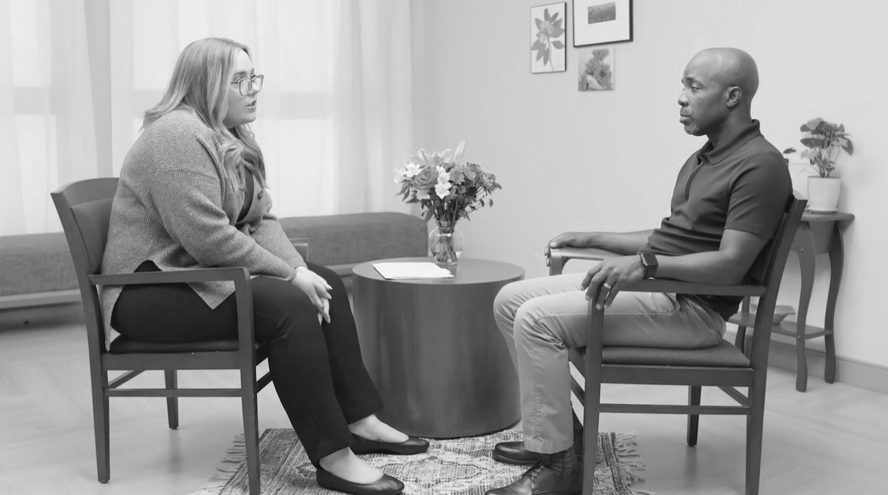
Non-Verbal & SOLER Skills
Why is our non-verbal communication important?
What does SOLER stand for?
  S - sitting squarely, facing the person
  O- open posture
  L - lean forward to show we are interested in what the person is talking about
  E – eye contact
  R – relaxed body language
  Demonstrate SOLER
  with your partner.
Notes:
Core Message: The SOLER framework and non-verbal communication are vital for fostering relationships and enhancing effective communication.
Say: SOLER is an acronym representing a set of essential non-verbal communication skills.
Do: Invite a few learners to discuss, "Why is non-verbal communication important?"
Request a volunteer to explain what each component of the SOLER acronym signifies.
Reveal the SOLER descriptions on the slide after the volunteer responds (they are designed to "fade in" and will not appear automatically). Ask another volunteer to demonstrate each element with their partner from the previous activity. Finally, instruct the larger group to pair up and practice SOLER.
The trainer should observe trainees' application of SOLER, moving around the room as needed.
Encourage a discussion reflecting on the experience from both the practitioner and client perspectives.
Trainer notes: This activity serves as a brief introduction to SOLER, preparing learners for further practice of these skills later in the module. Learners can pair with their previous partners to demonstrate SOLER.

Slide 12

Open-Ended Questions
Fosters in-depth discussions
Avoids closed-ended questions
Responses should encourage more than just yes, no, or brief answers
Promotes active listening over speaking
Allows adequate time for thoughtful responses
What examples of open-ended questions can you apply in your context?
Notes:
Core Message: Open-ended questions invite individuals to share information and foster deeper discussions.
Say: Open-ended questions encourage individuals to elaborate, providing more detailed responses and facilitating richer discussions. These questions allow for answers beyond simple yes or no responses. When you ask open-ended questions, focus on listening more and speaking less. Additionally, give the person time to think and respond after posing your question.
Do: To reinforce learning, invite a few volunteers to share an open-ended question they would use in their own context. For instance, in a supported employment program, an open-ended question could be, "What are some reasons you are interested in a specific education program or job?"
Trainer Notes: This activity serves as a review of the concepts covered in Module 2.

Slide 13
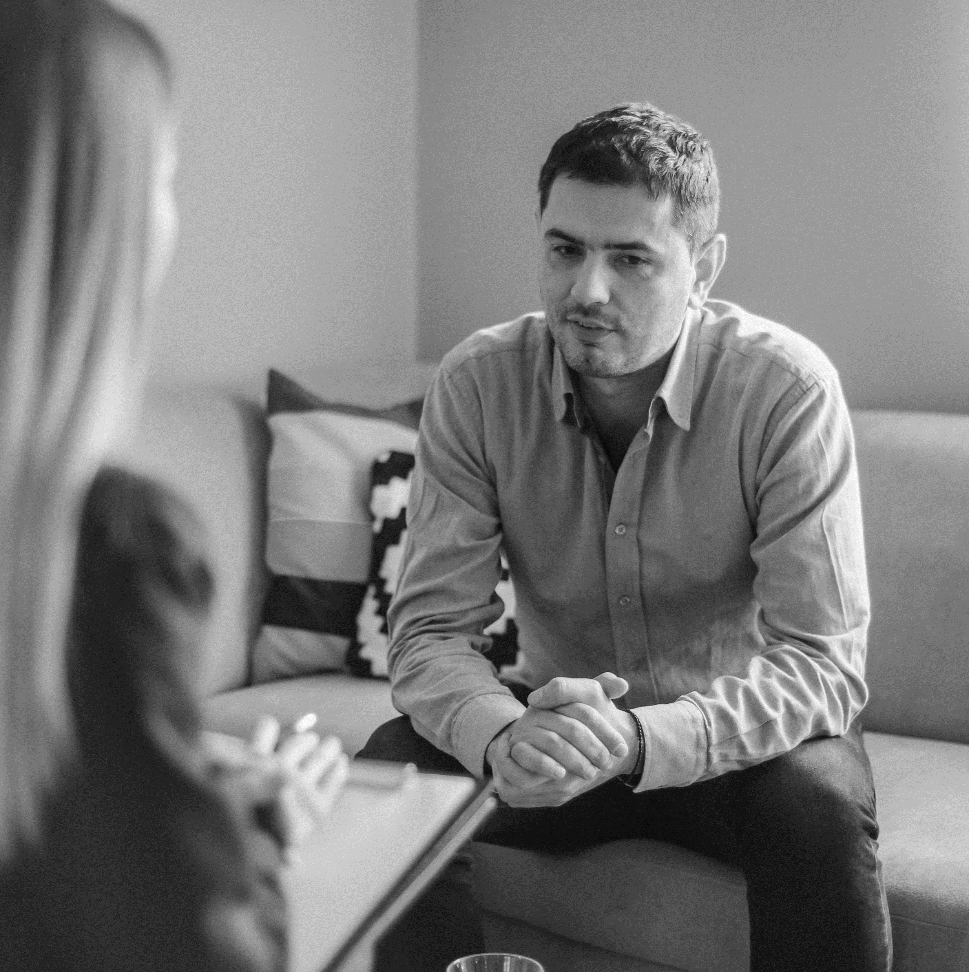

Reflective Responding
An evidence-based practice using formulated responses to talk with a person.
These include:
Content Responses
Feeling Responses
Meaning Responses
Notes:
Say: Reflective responding is essential for practitioners to accurately understand their clients' messages, demonstrate active listening, and encourage clients to share more about their significant concerns. This technique employs specific, predefined responses, three of which were introduced in Module 2.
Do: Instruct trainees to identify the three types of reflective responses. After collecting their answers, display the three types on the slide. Following this, prompt learners to describe how each type manifests in communication, using the prompts provided below. Solicit responses from several volunteers.
Trainer notes:
Content Responses: "So you’re saying..."
Feeling Responses: "You feel (feeling word)..."
Meaning Responses: "You feel (feeling word) because _________"

Slide 14

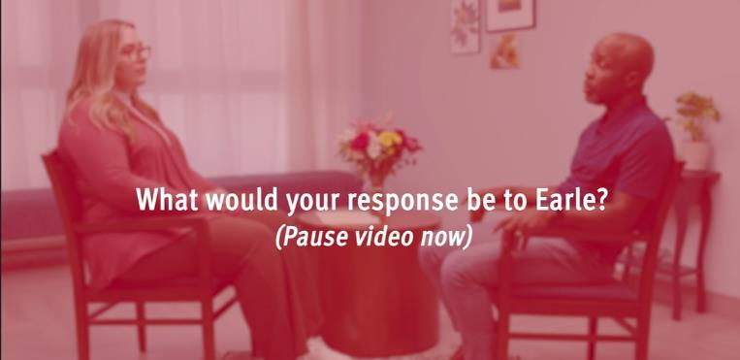
06_Mental Health Setting Module 03_PUTTING IT ALL TOGETHER
Notes:
Core message: Practice open ended questions and reflective responding skills.
Say: Now that we've had a refresher from modules one and two, let's see how you would respond. We're going to look at the same scenario from module one, where Earle was a client working with Crystal around his interest in returning to school. I'm going to play the video and pause it at certain points to allow you to provide a response. We'll go around the room and ask each of you to provide either an open-ended question, content, feeling, or meaning response. If you remember Crystal's response when you saw the video in module one, try to use an alternative one.
Do: play the video and pause when prompted. Include the introduction (below) by Ann. After each person has had an opportunity to provide their responses, move to the next slide to process the activity.
https://youtu.be/6DExdxiZFEY

Slide 15

How Did It Go?
Reflect on your experience in responding to Earle. How did it make you feel?
Identify one response that you found particularly effective.
What is one response that you believe could be improved?
Notes:
Core Message: Reflecting on the activity and assessing learners' feelings about their responses.
Say: Now that you have practiced formulating your own response, let’s discuss how it went.
Do: Encourage learners to share their overall feelings about responding to Earle, and to identify one response they believe was effective and one that could be improved.

Slide 16

Let’s Practice!
Form pairs.
Identify a five-year goal.
Assign roles: speaker and listener.
Practice effective communication skills, including open-ended questions and reflections on content, feelings, and meanings.
Switch roles after the first round.
Utilize all communication skills during the exercise.
Conclude with a class reflection.
“You’re saying ______________.”
Notes:
Do: Instruct the group to pair up with their partners.
Ask each partner to reflect on their five-year goals. Allow one to two minutes for this contemplation.
Next, designate one person as the Speaker to share their five-year goal. The other partner, the Listener, will apply the skills learned when responding to the Speaker.
After the first round, switch roles so that each person has the opportunity to practice all skills at least once.
Once everyone has practiced, facilitate a discussion by asking the following questions to process the activity:
What communication barriers, if any, did you encounter, such as LIME?
What positive communication qualities did the listener demonstrate?
How did you recognize that your partner was actively listening to you?
Trainer notes: Allocate at least 10 minutes for the pairing exercise and another 10 minutes for discussing the process questions. Observe participants as they practice their responses and provide individualized feedback as necessary.

Slide 17

Let’s Apply to Your Work Setting!
Rejoin your partner
Consider how you will apply these communication skills in your workplace. Please respond to the following questions:
What is the context of the situation?
Which skills will you utilize?
In what ways do you believe these skills will enhance your interactions with clients?
What obstacles might hinder your progress?
Notes:
Core message: Utilizing communication skills in the unique work and professional environments of learners.
Say: How will you apply these communication skills in your interactions with individuals in your professional settings? In pairs, identify a relevant situation from your current, past, or potential future experiences.
Do: Have the group respond to the questions on the slide (approximately five minutes). If time allows, invite each learner to share their responses.
Say: Having discussed various situations where you may have utilized these skills, consider seeking new opportunities to practice them and observe how they enhance your connections with clients.
Trainer notes: If learners struggle to identify situations, you may provide examples to stimulate their thinking.
Conducting an initial assessment with a client,
Helping job seekers in a Supported Employment program to clarify their work-related values.
Gathering information from individuals in a Supportive Housing program to identify housing options that align with their SMART goals.
Assisting an individual with a co-occurring substance use disorder and mental health condition by conducting a cost-benefit analysis.

Slide 18

3
Summary
Reflect on the most significant insight you gained from today’s session and your overall experience.
Identify one communication approach or strategy you plan to modify when interacting with others.
“
  Practice in your unique setting and specific practice situations.
“
Notes:
Core Message: Practice and apply the skills in learners' future settings.
Say:
We have discussed various skills that can assist you during your appointments with patients. Between now and our next meeting, I encourage you to implement some of these strategies. For instance, utilize SOLER, open-ended questions, and reflections with clients. Observe how patients respond after you apply these skills. Additionally, take note of your efforts to consider culture and disability.
This module offered an opportunity to review the qualities of effective communication and the barriers that can hinder it, which are essential in the helping professions. I hope you also had the chance to practice your communication skills in your unique settings and specific practice situations.
Trainer Notes: Inquire if anyone has questions. Encourage learners to share the most significant takeaway from today's session and the modules overall. Thank learners for their participation.

Slide 19

Grant # 1H79SM081783
Notes:
Funding for this project was from the Substance Abuse and Mental Health Services Administration.
Grant# 1H79SM081783
More info:
Dr. Ann Murphy
murphyaa@shp.rutgers.edu

