Slide 1


FOUNDATIONAL COMMUNICATION SKILLS
Physical Health Setting
Notes:
Say: Welcome to this training series focused on foundational communication skills in a physical health setting.
This series includes three modules:
Module 1 - Positive Communication and Barriers to Communication;
Module 2 - Active Listening Skills; and
Module 3 - Putting it All Together: Applying Communication Skills in Your Setting.
This training will provide a balanced approach, combining information, observations of skills in action, and opportunities for you to practice and apply these skills in your own environment.
Trainer note: This series lasts approximately six hours. Module 1 is designed to take about 90 minutes,
Module 2 is approximately 3 hours, and
Module 3 is also about 90 minutes.

Slide 2

In Conjunction With

Slide 3


Presents
Notes:
Logos and animation to match video.

Slide 4

1
Positive Communication and Barriers to Communication
Physical Health Setting
Notes:
Say: The first module is Positive Communications and Barriers to Communication.

Slide 5

Objectives
01
02
03
List helpful communication skills for helping professions
Describe the importance of non-verbal communication
Identify common communication barriers
Notes:
Say: Welcome to the first module of a three-part series aimed at enhancing essential communication skills for professionals in the helping fields. In today’s training, we will focus on three primary objectives.
First, we will identify effective communication skills and strategies for building connections with individuals in helping scenarios.
Next, we will delve into non-verbal communication and its significant role in promoting positive interactions.
Finally, we will analyze common communication barriers, including listening skills, speaking styles, challenging messages, and environmental factors.

Slide 6

Importance of Good Communication
Essential for helping professions to create effective "therapeutic" environments
What constitutes effective communication?
Notes:
Core Message: Effective communication is essential for fostering a "therapeutic" environment.
Say: Communication is crucial for health professionals in creating a positive "therapeutic" environment during appointments. Health providers, including nurses, physical therapists, physician assistants, and clinical lab specialists, interact with patients daily. Establishing a “therapeutic” environment in healthcare settings involves communicating in a manner that is welcoming, safe, respectful, and hopeful.
We often depend on our communication skills to cultivate this type of environment. Positive communication between health providers and patients is vital for building rapport and establishing a successful therapeutic relationship, which ultimately leads to improved health outcomes. While positive communication is important in every interaction, it is especially crucial when discussing challenging topics. Let’s take a moment to discuss positive communication.
Do: Ask the learners, "How would you define positive communication?" Gather at least three responses, summarize them, and thank the learners for sharing.
Ask, "How is positive communication utilized in our personal and professional lives? What are the benefits of employing effective communication techniques?" Gather at least three responses, summarize them, and thank the learners for sharing.
Trainer notes: You may adjust the time allocated for this exercise based on the number and length of learner responses. Allow at least five minutes for a meaningful discussion. It may be beneficial to emphasize the significance of this communication in your specific health setting (location, provider type) and its implications for patient outcomes.

Slide 7

Positive Communication …
A vital skill that builds strong relationships
Allows us to explore diverse experiences
Involves active listening, empathy, and understanding
Notes:
Stopped Here
Core Message: Effective communication connects us through listening and speaking.
Say:
Effective communication in health care encompasses a range of skills that involve acquiring new knowledge, practicing techniques, and modifying our behaviors.
This includes actively listening to others, conveying difficult information with sensitivity, and motivating individuals to consider changes in their health behaviors. Strong communication fosters positive relationships in various environments, whether at work or home. By honing our positive communication skills, we can establish trust, allowing us to gain insights into others' experiences, which enhances our interactions. We can delve into a person's experiences through open-ended questions and other evidence-based communication techniques.
Further discussions on these skills will occur in upcoming modules.
Additionally, communication involves listening attentively. In health care settings, there may be a tendency to prioritize speaking over listening to patients. However, research indicates that attentive listening significantly enhances our effectiveness as health care providers. Finally, communication requires empathy towards our patients and their experiences, which helps cultivate a genuine, caring connection that often leads to improved outcomes for those we assist.

Slide 8

Strategies
Prepare to listen actively
Pay attention to non-verbal cues
Pose open-ended questions
Allow sufficient time for responses
Convey clear messages
Minimize distractions
Notes:
Core Message: We can implement strategies to enhance positive communication.
Say: In healthcare, we engage with patients daily regarding their health. There are effective strategies we can employ to enhance positive communication. The first step is to prepare yourself to listen. This may involve taking a moment to breathe and focus. Remind yourself to be fully present with the patient in front of you and to let go of any distracting thoughts.
Another effective way to foster positive communication is by observing your patient's body language. Do they seem tense, upset, angry, or fearful? This can provide crucial insights into their experience of the situation. It may also indicate that we need to adjust our approach to offer more encouragement, reassurance, or support. Healthcare appointments can be stressful for patients, and if they are in distress, they may struggle to comprehend what you are saying, potentially leading to poorer health outcomes.
Asking open-ended questions can be highly beneficial for healthcare providers as it demonstrates interest in your patient and may yield valuable information about their health behaviors. It also helps build strong relationships, encouraging patients to return for follow-up care.
Healthcare is often filled with jargon, acronyms, and complex terminology. We can promote positive communication with patients by striving to convey our health messages simply and clearly. We can even ask the patient to repeat what we have just said in their own words to ensure they understand our message.
Lastly, minimizing distractions is crucial for effective communication. This could involve closing a door or curtain, silencing our phones and asking patients to do the same, and putting away charts or laptops when possible.
Do: Ask the learners:
Which of these strategies do you implement to facilitate positive communication?
Which of these strategies do you find most challenging to apply?

Slide 9


Examples of Positive Communication
Greet the patient as they enter the room
Organize and put away files and folders
Maintain an open body posture
Acknowledge the patient's situation
Offer support and reassurance
Encourage the patient to ask questions
Notes:
Core Message: Small actions can significantly enhance positive communication.
Say: We have discussed several general strategies that promote positive communication. Now, let’s explore how these strategies can be applied in practice. A good starting point is to greet patients as they enter the room by making eye contact and acknowledging their presence. Depending on the situation, you may also choose to shake their hand. It is essential to be aware of cultural and personal preferences regarding handshakes and physical touch. Additionally, putting away unnecessary files or closing a laptop when it is not in use signals to the patient that you are prepared to listen. We will delve deeper into this in later modules, but remember that non-verbal communication plays a crucial role in creating a welcoming environment; for instance, avoid crossing your arms and lean slightly forward to demonstrate engagement with the patient.
When delivering difficult news or discussing a procedure, it can be beneficial to verbally acknowledge the situation. For example, you might say, "I know this is difficult news to hear," or "I understand this procedure may be uncomfortable, and I will do my best to complete it quickly." In these moments, offering support, encouragement, and reassurance can be very helpful. You might inform the patient that you will be with them during the next phase of their healthcare or remind them that it is normal to feel distress in such situations and that recovery is possible with time.
Finally, we should encourage patients to ask questions, allowing them to feel a sense of control over the situation and ensuring they fully understand what is happening.
Do: Which of these examples are you most comfortable with? Which ones make you feel uncomfortable?

Slide 10

Barriers (Lime)
Listener
Interlocutor (Speaker)
Message
Environment
Notes:
Core Message: LIME serves as a valuable acronym for identifying barriers to effective communication.
Say: Effective communication is crucial in behavioral health care, yet various obstacles often hinder it. The "LIME" model, which stands for Listener, Interlocutor, Message, and Environment, provides a useful framework for understanding these barriers.
First, consider the Listener. What factors might impede their ability to hear a message? Potential barriers include hearing impairments, distractions, or preoccupation with other thoughts. For professionals, attempting to take notes while conversing can also obstruct effective listening. Next, examine the Interlocutor. What speaking challenges may arise during communication? Are there language barriers? Has the individual had a challenging day, leading to frustration that affects their communication style? Then, consider the Message. What are we discussing with the patient? Sometimes, the information we need to convey may be difficult for them to accept, such as sharing bad news or recommending a new treatment. If the message is distressing, the individual may become disengaged and unable to listen. Finally, reflect on the Environment. What external factors might affect communication? Loud noises in the hallway or an uncomfortable room temperature can be distracting. Consider whether other people, interruptions, or even the presence of a computer for note-taking might hinder open communication.
Do: Encourage individuals to identify barriers specific to their environments. What common LIME barriers do you encounter in your medical office? What challenges do you face as a speaker? What obstacles do you experience as a listener?

Slide 11

Qualities of a Good Listener
Reflect on someone in your life who exemplifies excellent listening skills.
What qualities do they possess that make you feel truly heard?
Notes:
Core Message: Effective listening can be demonstrated in various ways.
Say:
Listening is an essential skill in healthcare interactions. There are various ways to show that we are actively listening to others. We will explore this topic further, including the steps involved in listening and validating another person. For now, let’s begin by creating a list of qualities that define a good listener. We will take a few minutes to brainstorm these qualities.
Do:
Engage learners
Who in your life exemplifies a good listener?
What actions or words from that person make you feel heard?
Trainer Notes: - Request a few volunteers to share their responses.

Slide 12


Positive Communication Qualities
Listen actively
Pay attention to non-verbal cues
Foster relationships
Recognize and address challenges as they arise
Manage your stress effectively
Cultivate cultural awareness
Notes:
Core Message: Effective communication is essential for fostering positive interactions.
Key Points: Positive communication enhances therapeutic relationships through various strategies, including:
Prepare to listen by checking in with yourself. Listening involves giving the speaker your full attention without interruption. Remove distractions, withhold judgments, and avoid arguments. Demonstrate active listening by:
Exhibiting open and positive body language.
Rephrasing or paraphrasing what you’ve heard in your response.
Asking open-ended questions to gather more information.
Pay attention to non-verbal cues, as they provide insight into a person's feelings.
Examples include: Facial expressions, tone of voice, speech rate, body language, and posture.
Take proactive steps to cultivate positive relationships through communication by:
Showing genuine interest, which conveys that the person matters and you wish to understand them.
Using a warm and friendly tone, as it enhances non-verbal communication. Consider how you would like to be greeted by a professional in a supportive environment. Avoid sarcasm, anger, or hostility, as these can damage relationships.
Maintaining a non-judgmental stance. Listening without judgment fosters respect and care, strengthening connections and improving outcomes.
Acknowledge challenges in communication. Misunderstandings are common, and disagreements may arise. For instance, if a person expresses a desire to stop medication due to side effects, it’s important to address concerns without escalating tension.
Suggestions for handling communication difficulties include:
First, validate the person's thoughts and experiences. Acknowledge their perspective by saying something like, "I understand why you feel that way." The goal is to recognize their viewpoint, not to correct it.
Agree to disagree if necessary. If the conversation reaches a point of disagreement, it’s acceptable to acknowledge differing opinions while emphasizing your commitment to their health.
Manage your stress levels. Behavioral health providers must be aware of their own stress, as it can affect emotional regulation and the ability to support patients effectively.
Strategies include regularly checking in with your emotions throughout the day and engaging in self-care routines to maintain well-being.
Be mindful of cultural communication preferences. Start by asking patients how they prefer to be addressed. Recognize that cultural differences exist, such as varying views on eye contact. Educate yourself about your patients' cultural backgrounds to enhance communication.
your own.

Slide 13


Cultural and Disability Considerations
Recognize and accommodate individual communication needs.
Understand your cultural background and communication style.
Respect individual preferences for communication.
Use clear and straightforward language.
Allow additional time for effective communication.
Encourage feedback and actively seek clarification.
Practice empathy in all interactions.
Notes:
Core Message: We can enhance communication with patients from diverse cultural backgrounds.
Say: Effective communication with individuals who differ from us requires us to actively employ our listening skills and focus on various aspects. First, identify potential communication barriers, such as hearing difficulties, cognitive processing styles, and language differences. Next, understanding your own culture and communication style is essential, as communication is a two-way process. Taking time to explore the communication preferences of other cultures can be beneficial. When interacting with someone from a different cultural background, it is important to use simple language, avoiding jargon or slang. Additionally, consider the individual’s health literacy and their ability to comprehend complex medical terminology.
It is also crucial to allow extra time to ensure that the patient fully comprehends the information being conveyed. Pausing after asking a question can provide patients with the opportunity to formulate their inquiries. Individuals with mental health conditions may require more time than those without such conditions to process information and respond.
Another effective strategy is to invite feedback and clarification from your patients (e.g., summarize what you believe the patient is saying and ask for confirmation). This approach encourages patients to ask questions and reinforces their understanding of new information.
Lastly, employing empathy can help you understand how the patient is experiencing the interaction.
Do: Encourage learners to share their unique communication preferences and cultural styles with one another. Then, ask learners how these preferences or styles may facilitate or hinder effective communication.
Say: For instance, some individuals may prefer written communication, while discussing feelings may be more challenging for them. Additionally, some cultures view handshakes as a sign of respect, whereas others may find them uncomfortable.

Slide 14
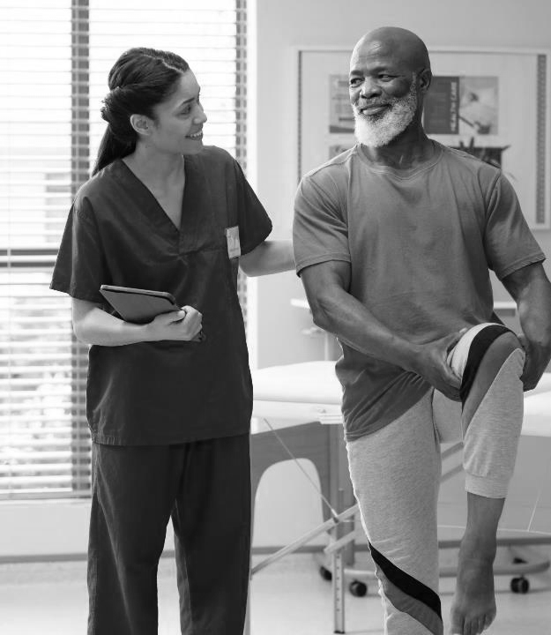
Engaging Others
Use open-ended questions to promote critical thinking.
Encourage exploration of personal interests and goals.
Offer choices to enhance decision-making skills.
Show respect and foster a sense of hope.
Recognize and celebrate individual strengths.
Notes:
Core Message: Healthcare professionals can implement strategies to enhance engagement, which in turn improves patient outcomes and satisfaction.
Say: Healthcare professionals depend on their ability to connect with others to effectively communicate information. This is often referred to as "engagement skills," encompassing the communication and social skills we utilize to foster motivation, cooperation, and learning. Our roles require us to interact with various individuals and establish positive working relationships with our patients.
Healthcare providers frequently engage with individuals who may be unwell, distressed, or unclear about the purpose of their visit. For instance, a patient may be referred by their primary care provider without fully understanding the reason for their appointment. They may also feel upset or frustrated regarding the necessary healthcare treatment for a specific issue.
In such situations, healthcare providers may need to employ additional communication skills to effectively engage the individual (e.g., engagement strategies).
Let’s explore some examples of engagement strategies now.
Open-ended questions, which encourage further conversation, can demonstrate genuine interest in the patient. They are also useful for gaining deeper insights into the individual. Questions beginning with “What” or “How” are particularly effective in fostering connections. For example, you might ask, "How are things going for you?"
Another effective way to engage a patient is by inquiring about their interests or future aspirations. Understanding more about the individual can enhance your ability to support their learning and motivation for change. A simple approach is to ask, "Tell me about yourself; what do you enjoy doing?" or "How does your current health impact what you enjoy doing?"
Offering choices is another strategy to connect with a patient. This can be as simple as asking where they prefer to sit or which topic they would like to discuss first. Allowing patients to make choices empowers them and conveys respect.
Healthcare providers can also express respect and hope for the individual, which fosters connections. Respect can be shown by listening attentively, using the person's preferred name or gender pronouns, and refraining from interruptions. Communicating hope for their recovery and well-being can be profoundly impactful for those seeking assistance. Research indicates that when healthcare providers express hopefulness, it leads to improved health outcomes.
Finally, healthcare providers can identify patients' strengths during interactions. Acknowledging strengths reminds patients of their resilience and capabilities, which can aid them in overcoming challenges. This practice often enhances the relationship between the provider and the patient.
Ask: Encourage learners to discuss the importance of engagement skills in their respective settings. As you gather responses, draw comparisons between different settings and highlight any unique aspects mentioned. Remind learners that utilizing engagement skills is a crucial component of healthcare work.

Slide 15

LIME for Positive Communication
Listener
Allow time for response
Check-in with yourself
Interlocutor (Speaker)
Focus communication on the individual
Message
Some topics may require more time and support
Environment
Be aware of noise, privacy and distractions
Notes:
Core Message: The LIME acronym serves as a valuable reminder of strategies for positive communication.
Say: Previously, we discussed communication barriers using the LIME model—Listener, Interlocutor, Message, and Environment—to identify challenges in our interactions. We can also apply the LIME model to highlight strategies that foster positive communication. Let’s explore each of the four categories with suggestions for enhancing communication with those you support.
Starting with the Listener: Consider who you are speaking to and what they may need to process your message. For instance, individuals who are upset, nervous, speak English as a second language, or have disabilities may require additional time to understand the information you provide. A strategy to encourage positive communication is to allow time for the person to respond and ask questions. Reflect on your own state as a listener. Are you tired or distracted? Have you set aside your phone? Prepare yourself for effective listening. When we are not at our best, taking a deep breath and refocusing our attention on the current patient can be beneficial.
At the Interlocutor or Speaker level, it is essential to focus your interaction on the patient. Often, patients are accompanied by caregivers, parents, or other healthcare professionals. To fully engage the patient, ensure you speak directly to them. When communicating, ask open-ended questions, allow time for responses, and strive for clarity in your messages.
Focusing on the message is also crucial. When delivering difficult health news or test results, it is important to be tactful. You may need to spend extra time or provide additional support to patients receiving such news. Consider your surroundings when sharing sensitive information, as the individual may need privacy to process the information without being overheard.
Think about the environment you are in. Minimize noise and distractions when speaking with patients by closing doors or silencing your phone. Move to a quieter location in the office or setting, away from waiting rooms or busy hallways.
Trainer Notes: Note that the LIME factors may vary with each interaction. You may be experiencing a good or bad day, your patient may be in a similar situation, or you may need to convey difficult news in an uncomfortable setting. The LIME model provides a framework for striving towards more positive communication.

Slide 16

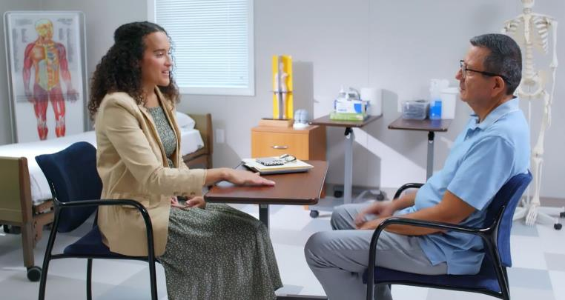
Video: Physical Health Mental Health M01 LIME
Notes:
Show video. Before the video begins ….
Say: In this video we'll be watching Dr. Aubrey Daniels working with Peter. Note that the practitioner's non-verbal actions that create a welcome environment. Also notice the non-verbal communication of the client. Based on the non-verbal communication, try to imagine what the person is feeling. Also, note how the practitioner creates a welcoming space.
Think about the LIME barriers to positive communication such as Listening, Interlocutor or Speaker, Message and Environment. Can you find any examples of LIME barriers that were addressed?
https://youtu.be/W2PbPGFEMIs?si=z41buo-tBhQ1IvHv

Slide 17

1
Summary
Positive communication is necessary in health care settings.
Communication includes listening, respect, awareness of self and attending to culture and disability.
LIME (Listener, Interlocutor, Message and Environment) can help us to overcome potential communication barriers.
“
LIME (Listener, Interlocutor, Message and Environment)
“
Notes:
Core Message: Effective communication involves actively engaging with the individual, listening attentively, and taking deliberate steps to foster interaction.
Overview: This module focuses on the essential elements of positive communication in health care settings. By listening, showing respect, acknowledging cultural differences, and being self-aware, we create an environment conducive to effective communication. The LIME model serves as a valuable tool for navigating potential challenges during interactions.
Trainer Notes: Encourage participants to ask questions. Additionally, invite learners to share their key takeaways from today's session. Thank them for their active participation.

Slide 18
1
In Practice
Recognize when you are listening attentively without distractions.
Acknowledge how you demonstrate respect in conversations.
Observe how you engage with a person's cultural background and disabilities.
Utilize LIME to address potential communication barriers.
Notes:
Core Message: You can immediately implement new positive communication techniques.
Say: Today, we discussed several skills that can enhance your interactions with patients. I encourage you to practice these strategies before our next meeting. For instance, observe whether you are listening with or without distractions. Reflect on how you demonstrate respect towards patients. Take note of your efforts to consider cultural and disability factors. Identify how you applied LIME in one of your interactions. During our next session, I will invite you to share your thoughts and experiences with a fellow learner.
Trainer note: If learners are unable to meet with a patient before our next session, encourage them to practice these skills with a friend or family member.

Slide 19

Grant # 1H79SM081783
Notes:
Funding for this project was from the Substance Abuse and Mental Health Services Administration.
Grant# 1H79SM081783
More info:
Dr. Ann Murphy
murphyaa@shp.rutgers.edu

